Slide 1
STOCHASTIC LOSS RESERVING USING BAYESIAN MCMC MODELS

Slide 2
Contents
1
Introduction
2
The CAS Loss Reserve Data
3
Validating the Mack Model
4
Validating the Bootstrap ODP Model
5
Bayesian Models for Incurred Loss Data
6
Bayesian Models for Paid Loss Data
7
Process Risk, Parameter Risk, and Model Risk
8
Summary and Conclusions

Slide 3
1. Introduction

Slide 4
1. Introduction
For general insurers, the most important liability is the reserve for unpaid losses. Over the years a number of stochastic models have been developed to address this problem. Two of the more prominent nonproprietary models are those of Mack (1993, 1994) and England and Verrall (2002).
While these, and other, models provide predictive distributions1 of the outcomes, very little work has been done to retrospectively test, or validate, the performance of these models in an organized fashion on a large number of insurers.

Slide 5
1. Introduction
Sections 3 and 4 attempt to validate the models of Mack (1993, 1994) and England and Verrall (2002). As it turns out, these models do not accurately predict the distribution of outcomes for the data included in the subject database. Explanation for these results include the following.

Slide 6
1. Introduction
The insurance loss environment is too dynamic to be captured in a single stochastic loss reserve model.
There could be other models that better fit the existing data.
The data used to calibrate the model is missing crucial information needed to make a reliable prediction. (e.g. changes in the direct/ceded/assumed reinsurance composition of the claim values in triangles)

Slide 7
1. Introduction
Possible ways to rule out the first item above are to
1. find a better model;
2. find better data.

Slide 8
2. The CAS Loss Reserve Database

Slide 9
2. The CAS Loss Reserve Database
In order to validate a model, one need not only the data used to build the model, but also the data with outcomes that the model was built to predict.
To illustrate the calculations in this monograph, I selected incurred and paid loss triangles from a single insurer in the database, whose data are in Tables 1, 2 and 3. The data in the loss triangles above the diagonal lines are available in the 1997 Annual Statement.

Slide 10
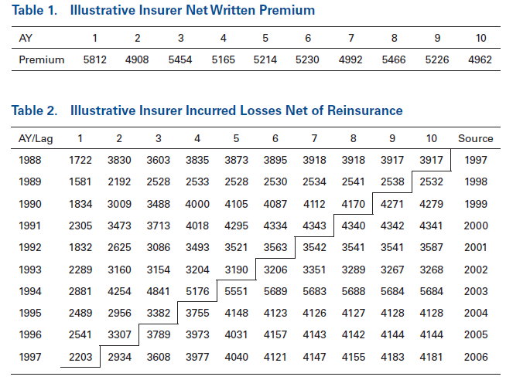
2. The CAS Loss Reserve Database

Slide 11
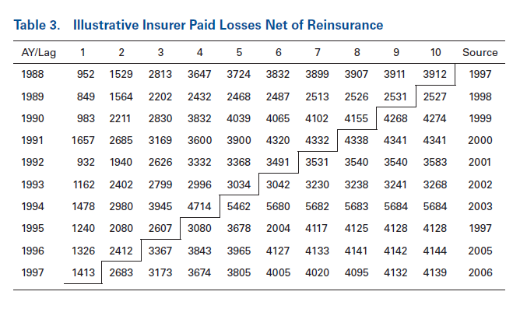
2. The CAS Loss Reserve Database

Slide 12
2. The CAS Loss Reserve Database
This monograph will fit various loss reserve models, and test the predictive distributions, to a set of 200 insurer loss triangles taken from four Schedule P (50 from each of Commercial Auto, Personal Auto, Workers Compensation and Other Liability) lines of insurance. An underlying assumption of these models is that there have not been any substantial changes in the insurer’s operation. In our real world, insurers are always tinkering with their operations. Schedule P provides two hints of possible insurer operational changes:
Changes in the net premium from year-to-year
Changes in the ratio of net to direct premium from year to year

Slide 13
3. Validating the Mack Model

Slide 14


3. Validating the Mack Model
To Begin with
the classic chain-ladder model
C_{w,d} , the accumulated loss amount, either incurred or paid
w, accident year , 1 ≤ w ≤ K
d, development lag, 1 ≤ d ≤ K
Age to age factor

Slide 15
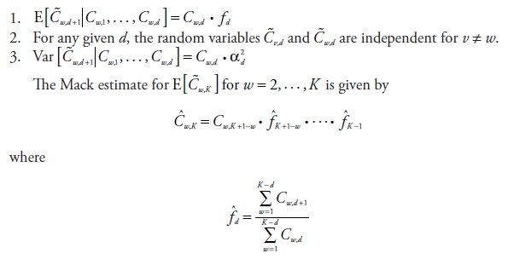
3. Validating the Mack Model
Mack Model
three assumptions

Slide 16
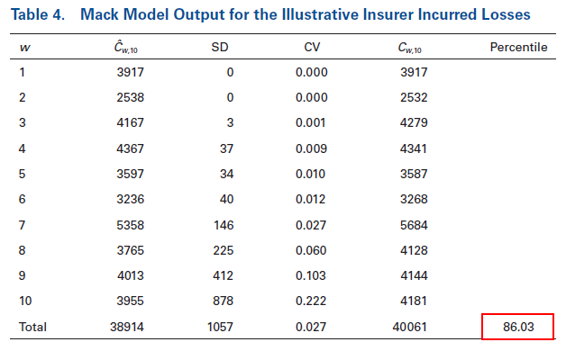
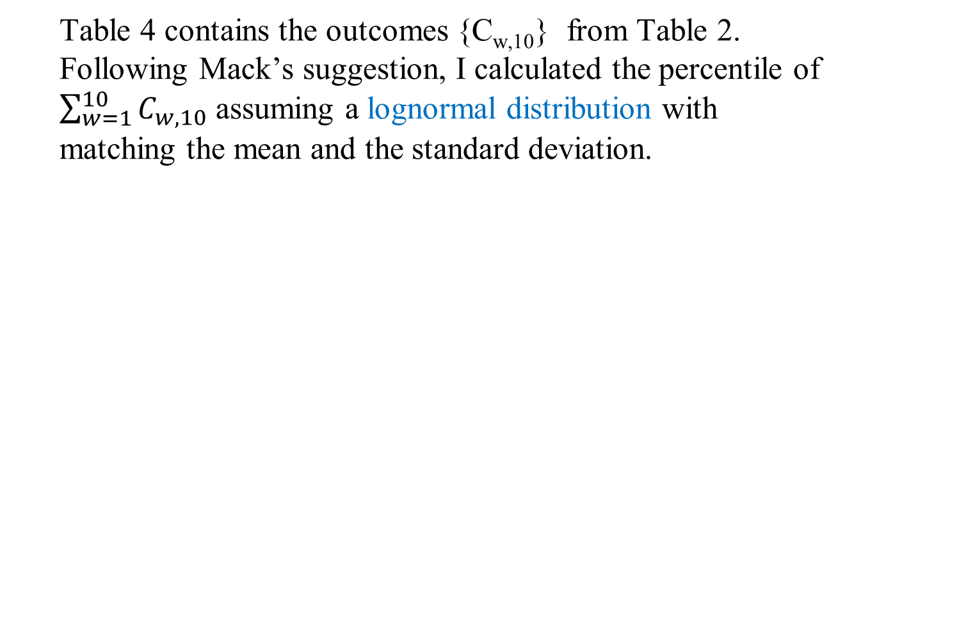
3. Validating the Mack Model
Table 4 contains the outcomes {C_{w,10}} from Table 2. Following Mack’s suggestion, I calculated the percentile of $\sum_{w=1}^{10}{C_{w,10}}$ assuming a lognormal distribution with matching the mean and the standard deviation.

Slide 17
3. Validating the Mack Model
My criteria for “general applicability of the model” is that these percentiles should be uniformly distributed.
Test for uniformly: histogram, p-p plot, K-S test

Slide 18
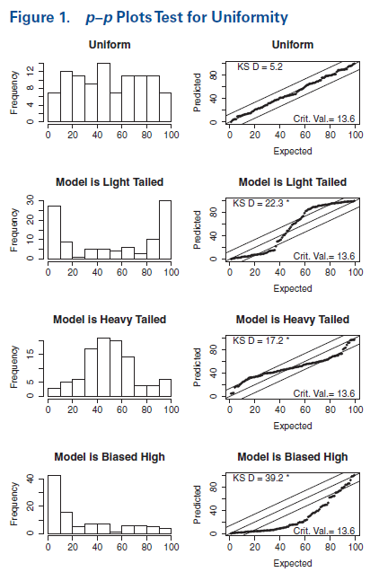
3. Validating the Mack Model
Uniform, 45° line
Light in tails, “S” curve
Heavy in tails, backward “S” curve

Slide 19
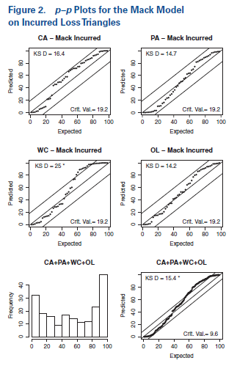
3. Validating the Mack Model
Three fall into the K-S band
“S” curve, means a light tailed predicted distribution
Combine all four lines, conclusion: the distribution predicted by the Mack model is too light in the tails for these data.

Slide 20
4. Validating the Bootstrap ODP Model

Slide 21

4. Validating the Bootstrap ODP Model
The bootstrap ODP model as described by England and Verrall (2002) was designed to work with incremental losses, I_{w,d}, rather than the cumulative losses, where I_{w,1} = C_{w,1} and I_{w,d} = C_{w,d} – C_{w,d-1} for d > 1.
A key assumption made by this model is that the incremental losses are described by the overdispersed Poisson distribution with
The parameters of the model can be estimated by a standard generalized linear model (GLM) package. They then use a bootstrap resampling procedure to quantify the volatility of the estimate.

Slide 22
4. Validating the Bootstrap ODP Model
England and Verrall point out that the using the ODP model on incremental losses almost all but requires one to use paid, rather than incurred, losses since the overdispersed Poisson model is defined only for nonnegative losses. Incurred losses include estimates by claims adjusters that can (and frequently do) get adjusted downward. Negative incremental paid losses occasionally occur because of salvage and subrogation, but a feature of the GLM estimation procedure allows for negative incremental losses as long as all column sums of the loss triangle remain positive.

Slide 23
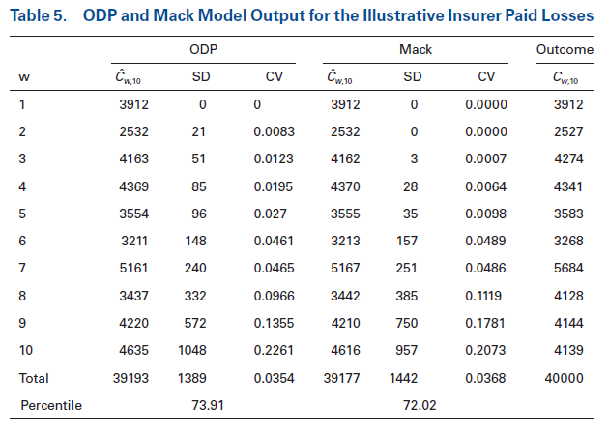
4. Validating the Bootstrap ODP Model
Table 5 gives the estimates of the mean, the standard deviation for both the ODP (with 10,000 bootstrap simulations) and Mack models on the data in Table 3.

Slide 24
4. Validating the Bootstrap ODP Model
The validation p–p plots, similar to those done in the previous section, for both the ODP and the Mack models on paid data, are in Figures 2 and 3.

Slide 25
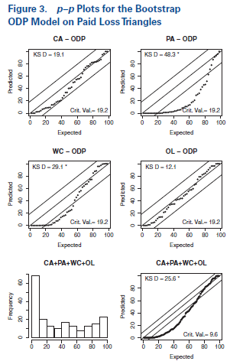
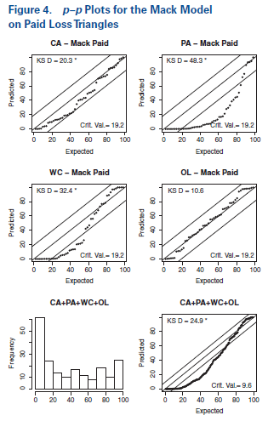
4. Validating the Bootstrap ODP Model

Slide 26
4. Validating the Bootstrap ODP Model
Neither model validates on the paid triangles. Figures 3 and 4 suggest that the expected loss estimates of both models tend to be too high for these data.
For incurred triangles, the distribution predicted by the Mack model has a light tail.
For paid triangles, the distributions predicted by both the Mack and the bootstrap ODP models tend to produce expected loss estimates that are too high. There are two plausible explanations for these observations:
1. The insurance loss environment has experienced changes that are not observable at the current time.
2. There are other models that can be validated.

Slide 27
5. Bayesian Models for Incurred Loss Data

Slide 28
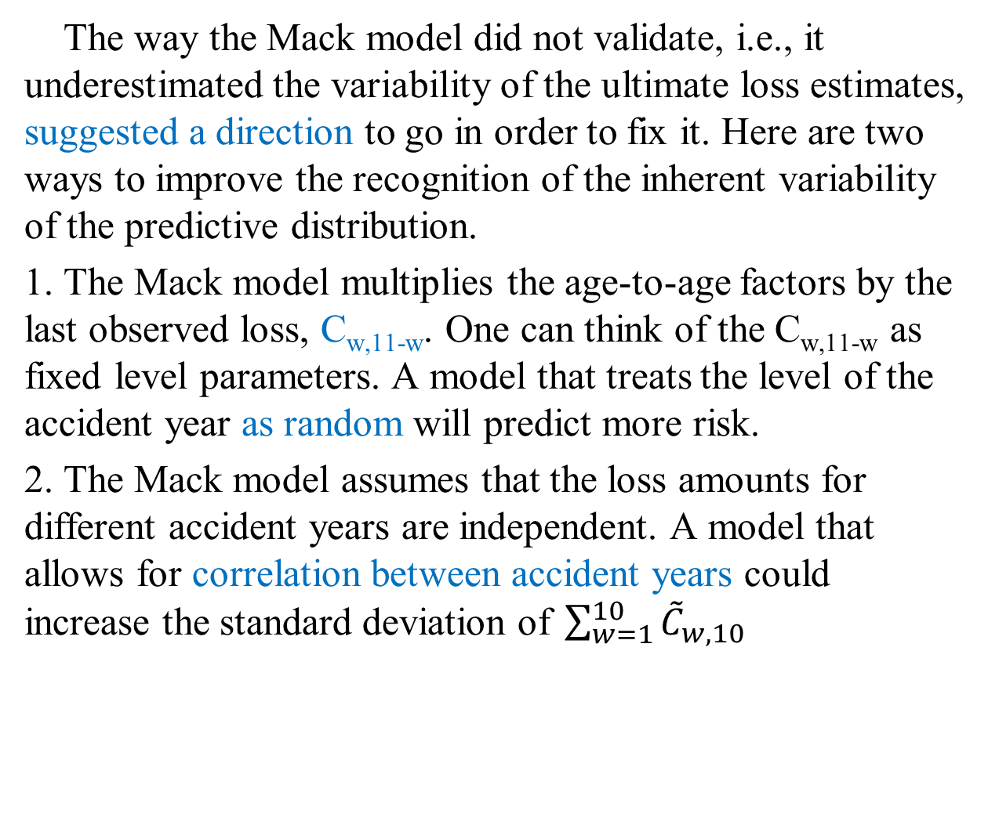
5. Bayesian Models for Incurred Loss Data
The way the Mack model did not validate, i.e., it underestimated the variability of the ultimate loss estimates, suggested a direction to go in order to fix it. Here are two ways to improve the recognition of the inherent variability of the predictive distribution.
1. The Mack model multiplies the age-to-age factors by the last observed loss, C_{w,11-w}. One can think of the C_{w,11-w} as fixed level parameters. A model that treats the level of the accident year as random will predict more risk.
2. The Mack model assumes that the loss amounts for different accident years are independent. A model that allows for correlation between accident years could increase the standard deviation of $\sum_{w=1}^{10}{{\tilde{C}}_{w,10}}$

Slide 29
5. Bayesian Models for Incurred Loss Data
I propose two different models to address the underestimation of the variability of the ultimate loss. The first model replaces the fixed level parameters, given by the last observed accident year, in the Mack model with random level parameters. As we shall see, this model improves the estimation of the variability, but does not go far enough. The second, and more complicated model, considers correlation between the accident years.

Slide 30
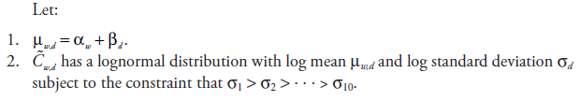
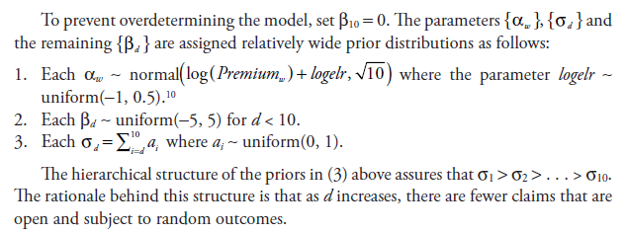
5. Bayesian Models for Incurred Loss Data
The Leveled Chain Ladder (LCL) Model

Slide 31
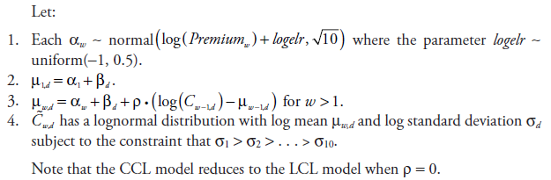
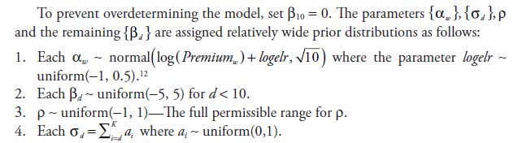
5. Bayesian Models for Incurred Loss Data
The Correlated Chain-Ladder (CCL) Model

Slide 32

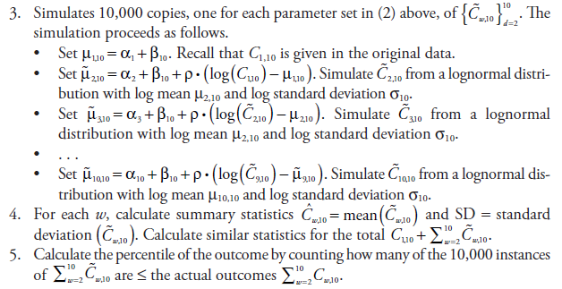
5. Bayesian Models for Incurred Loss Data
Simulate the predictive distribution

Slide 33
5. Bayesian Models for Incurred Loss Data
Table 7 gives the estimates of the mean and standard deviation, by accident year and in total, for the LCL, the CCL, and the Mack Models for the illustrative insurer. The predicted percentiles of the 40,061 outcome are also given for each model.

Slide 34
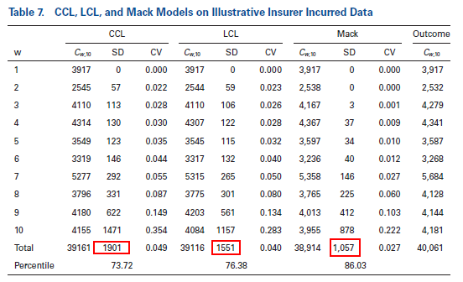
5. Bayesian Models for Incurred Loss Data

Slide 35
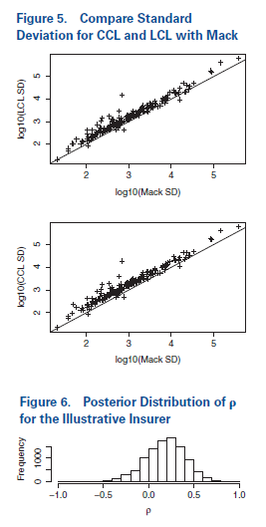
5. Bayesian Models for Incurred Loss Data
Note that the standard deviations of the predicted outcomes were significantly higher for the CCL and the LCL models than they were for the Mack Model. This is generally the case, as can be seen in Figure 5.

Slide 36
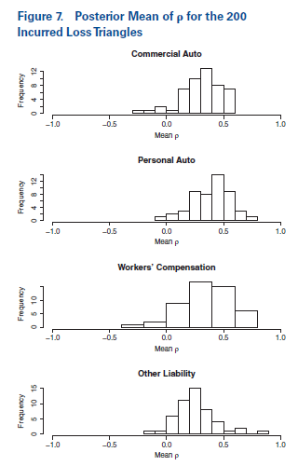
5. Bayesian Models for Incurred Loss Data
The higher standard deviations of the CCL model over the LCL model can be attributed to the generally positive correlation parameters that are shown in Figure 6 for the illustrative insurer. Generally this is the case for other insurers as can be seen in Figure 7.

Slide 37
5. Bayesian Models for Incurred Loss Data
The validation p–p plots for the LCL and CCL models run on the selected 200 triangles are given in Figures 8 and 9.
For the LCL model:
• The p–p plots combined lines of insurance lie within the Kolmogorov–Smrinov bounds for Commercial Auto, Personal Auto and Workers Comp.
• All four lines have the slanted S pattern that characterizes models that are too thin in the tails. This pattern is reinforced in the combined plot, and the resulting plot does not lie within the Kolmogorov–Smirnov bounds. But the combined plot is an improvement over the corresponding Mack p–p plot.

Slide 38
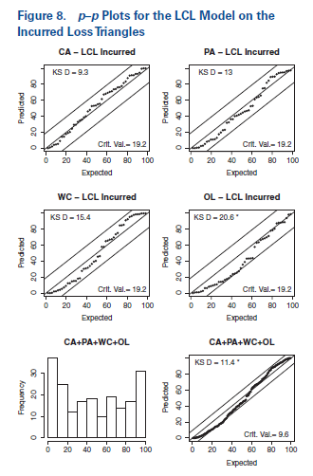
5. Bayesian Models for Incurred Loss Data

Slide 39
5. Bayesian Models for Incurred Loss Data
For the CCL Model:
• The p–p plots for all four lines lie within the Kolmogorov–Smirnov bounds, but just barely so for the Other Liability line.
• While the combined p–p plot lies within the Kolmogorov–Smirnov bounds, the slanted S pattern indicates a mildly thin tail predicted by the model.

Slide 40
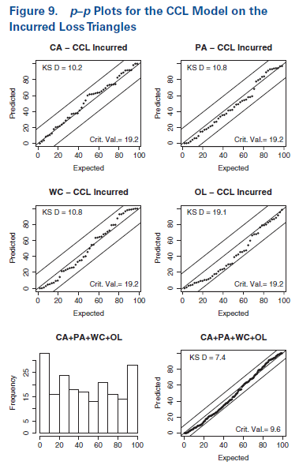
5. Bayesian Models for Incurred Loss Data

Slide 41
6. Bayesian Models for Paid Loss Data

Slide 42
6. Bayesian Models for Paid Loss Data
Given the improved validation of the CCL model on incurred loss data, it seems appropriate to try it out on paid loss data. Table 8 shows the CCL and ODP estimates. As should be expected given the results in Section 5, the standard deviation of the outcomes produced by the CCL model are noticeably higher than those produced by the ODP model.

Slide 43
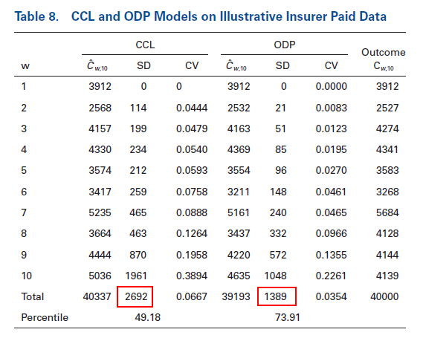
6. Bayesian Models for Paid Loss Data

Slide 44
6. Bayesian Models for Paid Loss Data
The validation p–p plots for the CCL model applied to paid data are in Figure 10. When comparing this plot with the validation p–p plots for the ODP model (Figure 3) and the Mack model (Figure 4), we see that all three models show tend to produced estimates that are too high for these loss triangles.

Slide 45
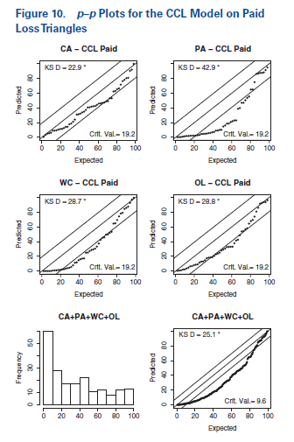
6. Bayesian Models for Paid Loss Data

Slide 46
6. Bayesian Models for Paid Loss Data
Given the improved validation of the CCL model with incurred loss data, it is tempting to conclude that the incurred loss data contains crucial information that is not present in the paid loss data. However, there is also the possibility that a model other than the ODP or the CCL may be appropriate. A feature of such a model might be that it has a trend along the payment year (= w + d - 1). The inclusion of a payment year trend in a model has two important consequences.
1. The model should be based on incremental paid loss amounts rather than cumulative paid loss amounts. Cumulative losses include settled claims which do not change with time.
2. Incremental paid loss amounts tend to be skewed to the right and are occasionally negative.

Slide 47
6. Bayesian Models for Paid Loss Data
One distribution that has these properties is the skew normal distribution. This distribution has three parameters.
1. μ—the location parameter.
2. ω—the scale parameter, with ω > 0.
3. δ—the shape parameter, with δ ∈ (-1, 1).

Slide 48
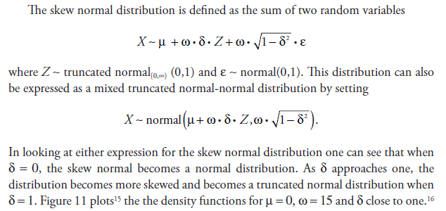
6. Bayesian Models for Paid Loss Data

Slide 49
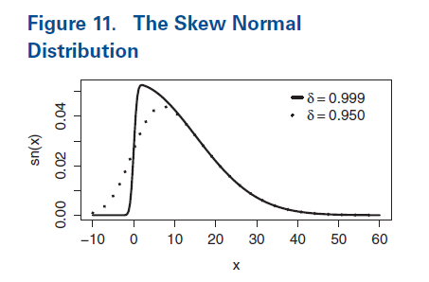
6. Bayesian Models for Paid Loss Data

Slide 50
6. Bayesian Models for Paid Loss Data
The formulation of the skew normal distribution described by Frühwirth-Schnatter and Pyne (2010) suggests an alternative. Simply replace the truncated normal distribution with another skewed distribution, such as the lognormal distribution. Here is one way to do that. Define
X ~normal (Z, δ), where Z ~lognormal (μ, σ).
Let’s call this distribution the mixed lognormal-normal (ln-n) distribution with parameters given by δ, μ and σ. Figure 12 plots the density functions for μ = 2, σ = 0.6, and two different values of δ.

Slide 51
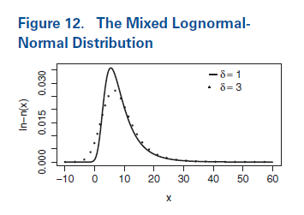
6. Bayesian Models for Paid Loss Data

Slide 52
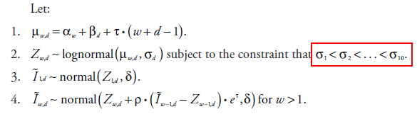
6. Bayesian Models for Paid Loss Data
The Correlated Increment Trend (CIT) Model
The CCL model was applied to cumulative losses. One should expect σ_{d} to decrease as d increases as a greater proportion of claims are settled.
In the CIT model, one should expect that the smaller less volatile claims to be settled earlier. Consequently, σ_{d} should increase as d increases.

Slide 53
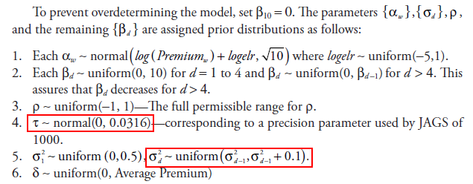
6. Bayesian Models for Paid Loss Data

Slide 54
6. Bayesian Models for Paid Loss Data
There are two deviations from the selection of diffuse prior distributions that are in the CCL model.
• I first tried a wider prior for τ. In examining the MCMC output I noticed that quite often, the value of τ was less than -0.1, which I took to be unreasonably low. This low value was usually compensated for by offsetting high values for the α and/or β parameters.
• In examining the MCMC output, I noticed that, occasionally, high values of σ_{d} would occur. This led to unreasonably high simulated losses in the output, so I decided to limit how fast σ_{d} could increase with d.

Slide 55
6. Bayesian Models for Paid Loss Data
By setting the prior distribution of ρ equal to zero, we eliminate the between accident year correlation. Following the naming convention of the last section, let’s call this model the Leveled Incremental Trend (LIT) model. Table 9 shows the estimates of for the illustrative insurer with the CIT and the LIT model on paid data.

Slide 56
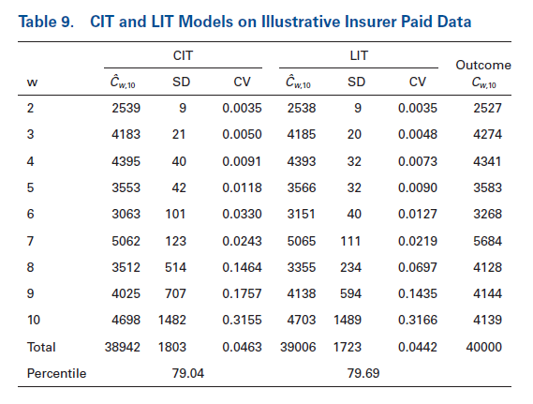
6. Bayesian Models for Paid Loss Data

Slide 57
6. Bayesian Models for Paid Loss Data
Before producing these distributions, I had no particular expectation of how ρ would be distributed for paid data. However, I did expect τ to be predominantly negative since the p–p plots in Figures 3, 4 and 10 indicted that the all the other models predicted results that were too high.
Let’s first examine the effects of between-year correlation in the CIT model. Figure 13 gives the posterior distributions for ρ for the illustrative insurer. Figure 14 gives the histograms of the posterior means ρ for each insurer by line of business.

Slide 58
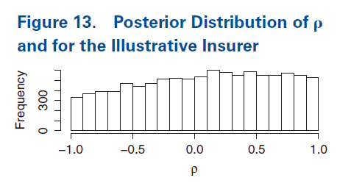
6. Bayesian Models for Paid Loss Data

Slide 59
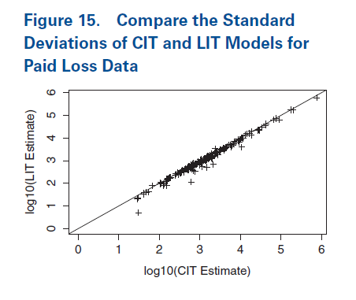
6. Bayesian Models for Paid Loss Data
As seen in Figure 14, the posterior means of ρ for the paid data were not as overwhelmingly positive as we saw in the incurred data shown in Figure 7. Figure 15 shows a small but noticeable difference between the standard deviations of the CIT and LIT models.

Slide 60
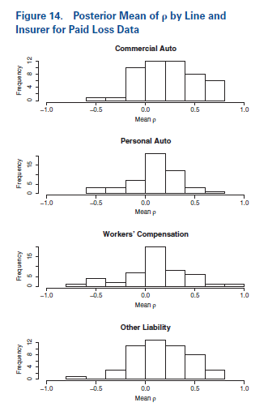
6. Bayesian Models for Paid Loss Data

Slide 61
6. Bayesian Models for Paid Loss Data
As seen in Figure 17, the posterior means of τ were predominantly negative. But as pointed out above, a negative might be offset by higher {α_{w} }s and d {β_{d} }s. Figure 18 shows only a handful of triangles where there was a noticeable decrease in the final expected loss estimates. And most of those differences appeared in the Other Liability line of business.

Slide 62
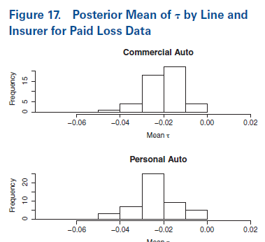
6. Bayesian Models for Paid Loss Data

Slide 63
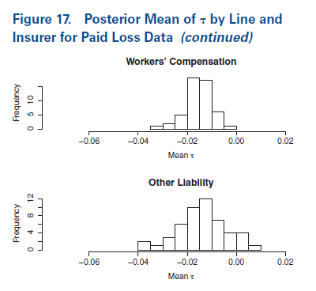
6. Bayesian Models for Paid Loss Data

Slide 64
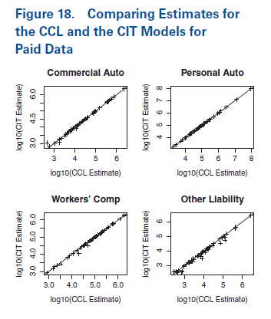
6. Bayesian Models for Paid Loss Data

Slide 65
6. Bayesian Models for Paid Loss Data
Figures 19 and 20 show the validation p–p plots for the CIT and the LIT models. As do the Mack, ODP and CCL models on paid data indicate, the predictive distributions for the CIT and LIT models tend to overstate the estimates of the expected loss.

Slide 66
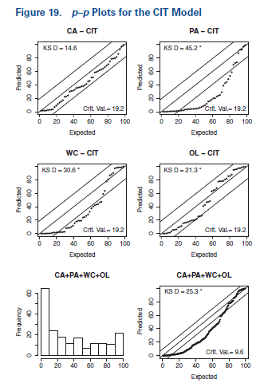
6. Bayesian Models for Paid Loss Data

Slide 67
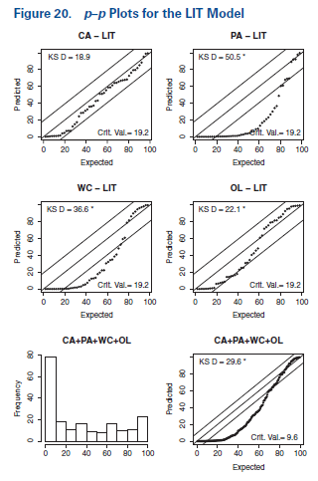
6. Bayesian Models for Paid Loss Data

Slide 68
6. Bayesian Models for Paid Loss Data
So, in spite of a serious attempt to improve on the results produced by the earlier models on paid data, the CIT and LIT models did not achieve the desired improvement. This result tends to support the idea that is generally accepted, that the incurred data reflects real information that is not in the paid data.
A reviewer of this monograph checked with some colleagues and found that claims are “reported and settled faster today due to technology,” and suggested that the CIT model might not fully reflect this change. A model that addresses the possibility of a speedup of claim settlement is the following.

Slide 69
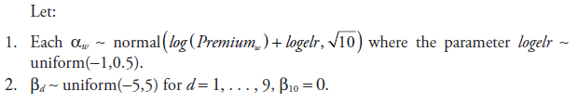
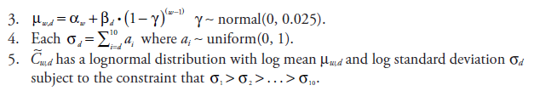
6. Bayesian Models for Paid Loss Data
The Changing Settlement Rate (CSR) Model
Since β₁₀ = 0 and cumulative paid losses generally increase with the development year, d, β_{d} for d < 10 is usually negative. Then for each d < 10, a positive value of γ will cause β_{d `}(1-γ)^{(w-1)} to increase with w and thus indicate a speedup in claim settlement. Similarly, a negative value of γ will indicate a slowdown in claim settlement.
Table 10 shows the results for the CSR model on the illustrative insurer.

Slide 70
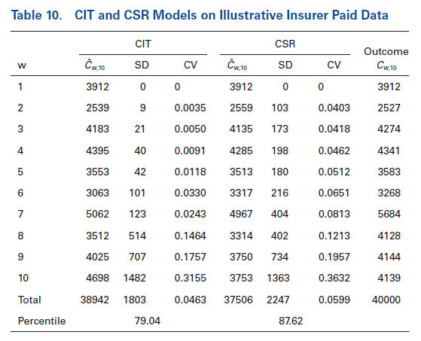
6. Bayesian Models for Paid Loss Data

Slide 71
6. Bayesian Models for Paid Loss Data
The validation p–p plots in Figure 22 shows that for three of the four lines of insurance, the CSR model corrects the bias found in the earlier models. This model also correctly predicts the spread of the predicted percentile of the outcomes for those lines. While the CSR model still exhibits bias for the personal auto line of business, the bias is significantly smaller than that of the other models.
It appears that the incurred loss data recognized the speedup in claim settlements.

Slide 72
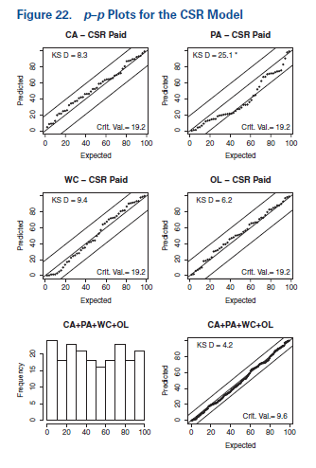
6. Bayesian Models for Paid Loss Data

Slide 73
7. Process Risk, Parameter Risk, and Model Risk

Slide 74

7. Process Risk, Parameter Risk, and Model Risk
Let us now address a topic that frequently comes up in stochastic modeling discussions – process risk, parameter risk and model risk. One way to describe process and parameter risk is to consider the relationship for a random variable X conditioned on a parameter θ.
Let’s call the left side of the above equation the “Total Risk.” Let’s call the first term of the right side the “Process Risk” as it represents the average variance of the outcomes from the expected result. Finally, let’s call the second term the “Parameter Risk” as it represents the variance due to the many possible parameters in the posterior distribution. Another often-used term that overlaps with parameter risk is the “range of reasonable estimates.”

Slide 75


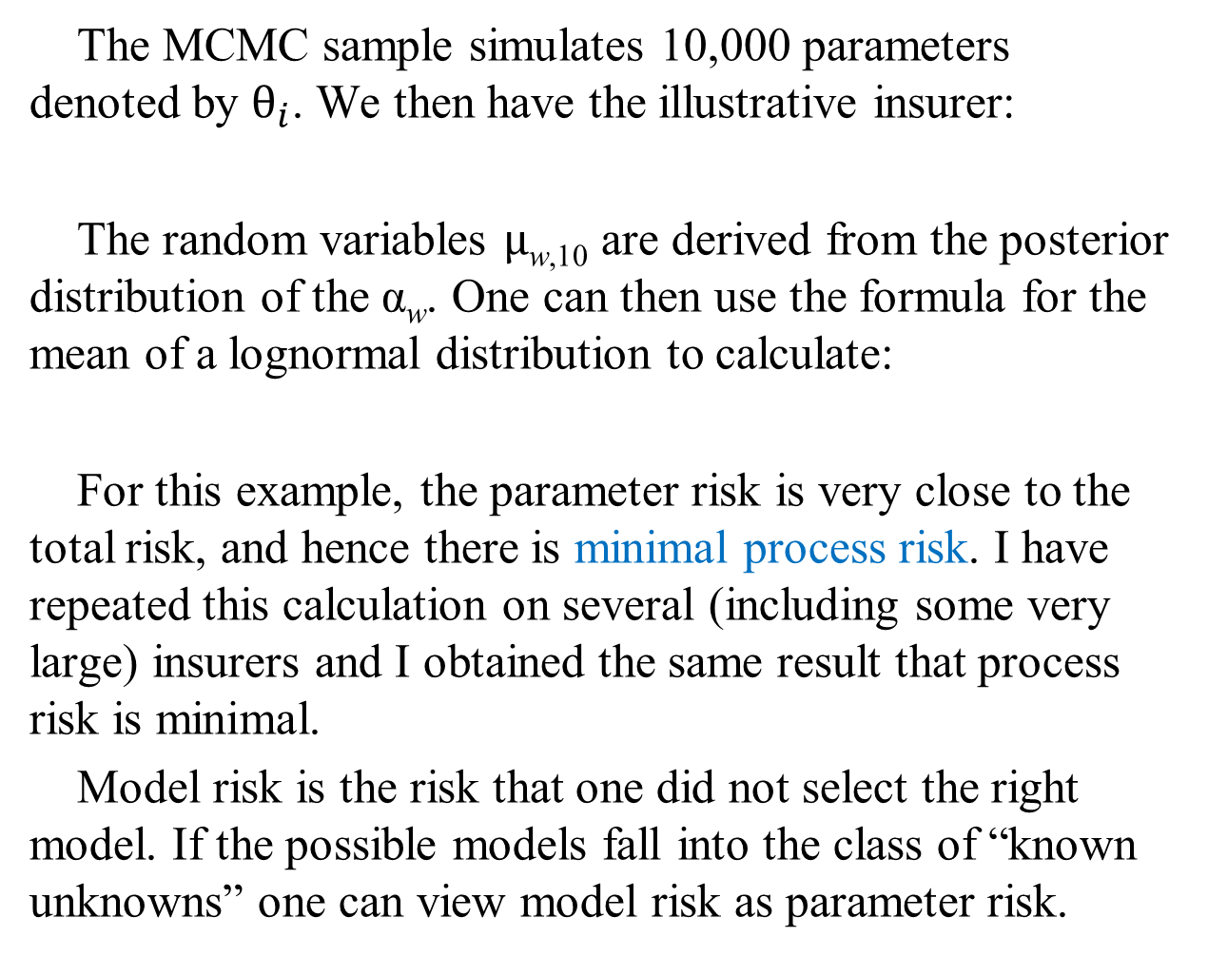
7. Process Risk, Parameter Risk, and Model Risk
The MCMC sample simulates 10,000 parameters denoted by $θ_{i}$. We then have the illustrative insurer:
The random variables $μ$_{w,10} are derived from the posterior distribution of the α_{w}. One can then use the formula for the mean of a lognormal distribution to calculate:
For this example, the parameter risk is very close to the total risk, and hence there is minimal process risk. I have repeated this calculation on several (including some very large) insurers and I obtained the same result that process risk is minimal.
Model risk is the risk that one did not select the right model. If the possible models fall into the class of “known unknowns” one can view model risk as parameter risk.

Slide 76
8. Summary and Conclusions

Slide 77
8. Summary and Conclusions
The central thrust of this monograph is twofold.
• It implements the idea of large-scale retrospective testing of stochastic loss reserve models on real data. The goal is not to comment on the reserves of individual insurers. Instead the goal is to test the predictive accuracy of specific models.
• As shortcomings in existing models are identified, it demonstrates that Bayesian MCMC models can be developed to overcome some of these shortcomings.

Slide 78
8. Summary and Conclusions
Here is a high-level summary of the results obtained with these data.
• For incurred data, the variability predicted by Mack model is understated. One of its key assumptions is that the losses from different accident years are independent. This monograph proposes the correlated chain ladder (CCL) model as an alternative. This model allows for a particular form of dependency between accident years. It finds that the CCL model predicts the distribution of outcome correctly within a specified confidence level.

Slide 79
8. Summary and Conclusions
For paid data, the bootstrap ODP model, the Mack model and the CCL model tend to give estimates of the expected ultimate loss that are high. This suggests that there is a change in the loss environment that is not being captured in these models. This monograph proposes three models, the Leveled Incremental Trend (LIT), the Correlated Incremental Trend (CIT) model, and the Changing Settlement Rate (CSR) as alternatives. The first two models allow for payment year trends. While the introduction of a payment year trend seems plausible given the bias identified in the earlier models, the performance of the LIT and CIT models are similar to the earlier models in the validation p–p plots. The CSR model corrects the bias identified in the previous models for three of the four lines of insurance, and has significantly less bias on the fourth line of insurance.

Slide 80

Thank You !

